Slide 1
Web工学 (Web Engineering) http://tinyurl.com/webeng2009
豊田正史 (Masashi Toyoda)
mtoyoda@acm.org

Slide 2
目標
Goal
Webに関する研究分野の最近の動向について学ぶ
Learn Web related research and its recent trends

Slide 3
進め方
Format
論文の輪講形式
毎回3,4本の論文を担当者が発表する
論文はメジャーな国際会議から選択 (WWW2009)
Seminar style
Three (or four?) students present research papers at each session
Papers are selected from measure international conferences (WWW2009)

Slide 4
単位
Credits
出席は取らない
条件：
発表を1回行う OR
レポートを2回提出 OR
レポートを1回提出、かつ3回以上議論に参加する
(レポートは発表されない論文のまとめ）
No roll call
Conditions:
1 presentation, OR
2 reports, OR
1 report, and 3 or more participation to the discussion
(A report is required to describe a summary of a paper not presented in the sessions)

Slide 5
WWW2009 (4/20-4/24, Madrid）
The most prestigious conference on WWW
13 research tracks
888 submissions, accepted 104 papers (12％)
14 tutorials
10 workshops (AIRWeb, WICOW, …)
Papers are open public at:
http://www2009.eprints.org
http://www2009.org/proceedings/table.html

Slide 6
Research Tracks

Slide 7
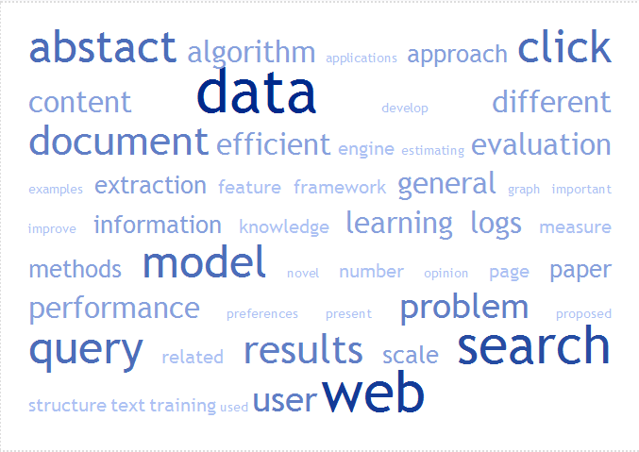

Data Mining Track (22 papers)
タイトル、アブストラクトより抽出

Slide 8
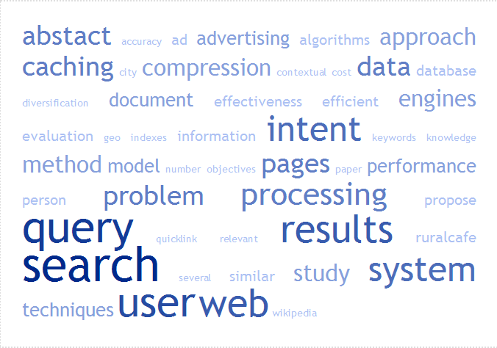
Search Track (15 papers)

Slide 9
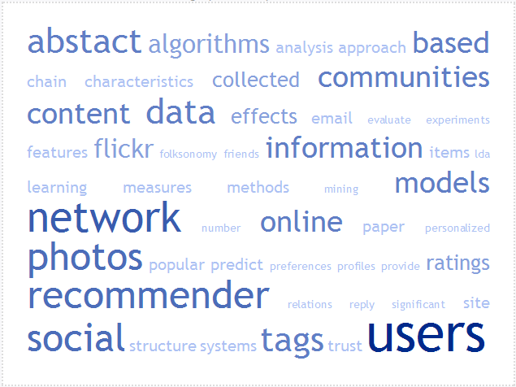
Social Networks and Web 2.0 Track (12 papers)

Slide 10
Data Mining - Text
Detecting the Origin of Text Segments Efficiently (Page 61) Ossama Abdel Hamid (Cairo University), Behshad Behzadi (Google Inc.), Stefan Christoph (Google Inc.), Monika Henzinger (Google Inc. and EPFL Lausanne)
Efficient Overlap and Content Reuse Detection in Blogs and Online News Articles (Page 81) Jong Wook Kim (Arizona State University), K. Selc,uk Candan (Arizona State University), Junichi Tatemura (NEC Laboratories, America)

Slide 11
Data Mining – Learning
Latent Space Domain Transfer between High Dimensional Overlapping Distributions (Page 91) Sihong Xie (Sun Yat-Sen University), Wei Fan (IBM T.J. Watson Research Center), Jing Peng (Montclair State University), Olivier Verscheure (IBM T.J. Watson Research Center), Jiangtao Ren (Sun Yat-Sen University and Montclair State University)
StatSnowball: a Statistical Approach to Extracting Entity Relationships (Page 101) Jun Zhu (Tsinghua University), Zaiqing Nie (Microsoft Research Asia), Xiaojiang Liu (University of Science and Technology of China), Bo Zhang (Tsinghua University), Ji-Rong Wen (Microsoft Research Asia)

Slide 12
Data Mining
Fast Dynamic Reranking in Large Graphs (Page 31) Purnamrita Sarkar (Carnegie Mellon University), Andrew W. Moore (Google Inc.)
Estimating the ImpressionRank of Web Pages (Page 41) Ziv Bar-Yossef (Technion and Google Haifa Engineering Center), Maxim Gurevich (Technion)
Learning to Recognize Reliable Users and Content in Social Media with Coupled Mutual Reinforcement (Page 51) Jiang Bian (Georgia Institute of Technology), Yandong Liu (Emory University), Ding Zhou (Facebook Inc.), Eugene Agichtein (Emory University), Hongyuan Zha (Georgia Institute of Technology)
Click Chain Model in Web Search (Page 11) Fan Guo (Carnegie Mellon University), Chao Liu (Microsoft Research Redmond), Anitha Kannan (Microsoft Research Search Laboratories), Tom Minka (Microsoft Research Cambridge), Michael Taylor (Microsoft Research Cambridge), Yi-Min Wang (Microsoft Research Redmond), Christos Faloutsos (Carnegie Mellon University)

Slide 13
Data Mining
Exploiting Web Search to Generate Synonyms for Entities (Page 151) Surajit Chaudhuri (Microsoft Research), Venkatesh Ganti (Microsoft Research), Dong Xin (Microsoft Research)
Smart Miner: A New Framework for Mining Large Scale Web Usage Data (Page 161) Murat Ali Bayir (University at Buffalo, SUNY), Ismail Hakki Toroslu (Middle East Technical University), Ahmet Cosar (Middle East Technical University), Guven Fidan (AGMLAB Information Technologies)
Releasing Search Queries and Clicks Privately (Page 171) Aleksandra Korolova (Stanford University), Krishnaram Kenthapadi (Microsoft Research), Nina Mishra (Microsoft Research), Alexandros Ntoulas (Microsoft Research)

Slide 14
Data Mining - Opinions
Rated Aspect Summarization of Short Comments (Page 131) Yue Lu (University of Illinois at Urbana-Champaign), ChengXiang Zhai (University of Illinois at Urbana-Champaign), Neel Sundaresan (eBay Research Laboratories)
How Opinions are Received by Online Communities: A Case Study on Amazon.com Helpfulness Votes (Page 141) Cristian Danescu-Niculescu-Mizil (Cornell University), Gueorgi Kossinets (Google Inc.), Jon Kleinberg (Cornell University), Lillian Lee (Cornell University)

Slide 15
Search – Query & Ads
Unsupervised Query Categorization using Automatically-Built Concept Graphs (Page 461) Eustache Diemert (Yahoo! Inc.), Gilles Vandelle (Yahoo! Inc.)
Understanding User's Query Intent with Wikipedia (Page 471) Jian Hu (Microsoft Research Asia), Gang Wang (Microsoft Research Asia), Fred Lochovsky (The Hong Kong University of Science and Technology), Jian-tao Sun (Microsoft Research Asia), Zheng Chen (Microsoft Research Asia)
Discovering Users' Specific Geo Intention in Web Search (Page 481) Xing Yi (University of Massachusetts, Amherst), Hema Raghavan (Yahoo! Inc.), Chris Leggetter (Yahoo! Inc.)
A Search-based Method for Forecasting Ad Impression in Contextual Advertising (Page 491) Xuerui Wang (University of Massachusetts), Andrei Broder (Yahoo! Research), Marcus Fontoura (Yahoo! Research), Vanja Josifovski (Yahoo! Research)
Exploiting Web Search Engines to Search Structured Databases (Page 501) Sanjay Agrawal (Microsoft Research), Kaushik Chakrabarti (Microsoft Research), Surajit Chaudhuri (Microsoft Research), Venkatesh Ganti (Microsoft Research), Arnd Christian Konig (Microsoft Research), Dong Xin (Microsoft Research)
Online Expansion of Rare Queries for Sponsored Search (Page 511) Andrei Broder (Yahoo! Research), Peter Ciccolo (Yahoo! Research), Evgeniy Gabrilovich (Yahoo! Research), Vanja Josifovski (Yahoo! Research), Donald Metzler (Yahoo! Research), Lance Riedel (Yahoo! Research), Jeffrey Yuan (Yahoo! Research)

Slide 16
Search – Indexing & Caching
Inverted Index Compression and Query Processing with Optimized Document Ordering (Page 401) Hao Yan (Polytechnic Institute of New York University), Shuai Ding (Polytechnic Institute of New York University), Torsten Suel (Yahoo! Research)
Improved Techniques for Result Caching in Web Search Engines (Page 431) Qingqing Gan (Polytechnic Institute of New York University), Torsten Suel (Yahoo! Research)
Nearest-Neighbor Caching for Content-Match Applications (Page 441) Sandeep Pandey (Yahoo! Research), Andrei Broder (Yahoo! Research), Flavio Chierichetti (Sapienza University of Rome), Vanja Josifovski (Yahoo! Research), Ravi Kumar (Yahoo! Research), Sergei Vassilvitskii (Yahoo! Research)

Slide 17
Social Networks - Communities
Community Gravity: Measuring Bidirectional Effects by Trust and Rating on Online Social Networks (Page 751) Yutaka Matsuo (University of Tokyo), Hikaru Yamamoto (Seikei University)
The Slashdot Zoo: Mining a Social Network with Negative Edges (Page 741) Je'ro^me Kunegis (Technical University at Berlin), Andreas Lommatzsch (Technical University at Berlin), Christian Bauckhage (Deutsche Telekom Laboratories)
Network Analysis of Collaboration Structure in Wikipedia (Page 731) Ulrik Brandes (University of Konstanz), Patrick Kenis (TiasNimbas Business School & Tilburg University), Ju"rgen Lerner (University of Konstanz), Denise van Raaij (Tilburg University)
Social Search in "Small-World" Experiments (Page 701) Sharad Goel (Yahoo! Research), Roby Muhamad (Columbia University), Duncan Watts (Yahoo! Research and Columbia University)
Behavioral Profiles for Advanced Email Features (Page 711) Thomas Karagiannis (Microsoft Research Cambridge), Milan Vojnovic (Microsoft Research Cambridge)
A Measurement-driven Analysis of Information Propagation in the Flickr Social Network (Page 721) Meeyoung Cha (MPI-SWS), Alan Mislove (MPI-SWS), Krishna P. Gummadi (MPI-SWS)

Slide 18
Social Networks - Recommendation
Tagommenders: Connecting Users to Items through Tags (Page 671) Shilad Sen (Macalester College), Jesse Vig (University of Minnesota), John Riedl (University of Minnesota)
Collaborative Filtering for Orkut Communities: Discovery of User Latent Behavior (Page 681) Wen-Yen Chen (University of California, Santa Barbara), Jon-Chyuan Chu (Massachusetts Institute of Technology), Junyi Luan (Peking University), Hongjie Bai (Google Research China), Yi Wang (Google Research China), Edward Y. Chang (Google Research China)
Personalized Recommendation on Dynamic Content Using Predictive Bilinear Models (Page 691) Wei Chu (Yahoo! Laboratories), Seung-Taek Park (Yahoo! Laboratories)

Slide 19
Social Networks
Evaluating Similarity Measures for Emergent Semantics of Social Tagging (Page 641) Benjamin Markines (Indiana University and Institute for Scientific Interchange Foundation), Ciro Cattuto (Institute for Scientific Interchange Foundation), Filippo Menczer (Indiana University and Institute for Scientific Interchange Foundation), Dominik Benz (University of Kassel), Andreas Hotho (University of Kassel), Gerd Stumme (University of Kassel)
Measuring the Similarity between Implicit Semantic Relations from the Web (Page 651) Danushka Bollegala (The University of Tokyo), Yutaka Matsuo (The University of Tokyo), Mitsuru Ishizuka (The University of Tokyo)

Slide 20
Rich Media
Mapping the World's Photos (Page 761) David Crandall (Cornell University), Lars Backstrom (Cornell University), Daniel Huttenlocher (Cornell University), Jon Kleinberg (Cornell University)
Less Talk, More Rock: Automated Organization of Community-Contributed Collections of Concert Videos (Page 311) Lyndon Kennedy (Yahoo! Research), Mor Naaman (Rutgers University)
Visual Diversification of Image Search Results (Page 341) Reinier H. van Leuken (Universiteit Utrecht), Lluis Garcia (Yahoo! Research), Ximena Olivares (Unversitat Pompeu Fabra), Roelof van Zwol (Yahoo! Research)
Tag Ranking (Page 351) Dong Liu (Harbin Institute of Technology), Xian-Sheng Hua (Microsoft Research Asia), Linjun Yang (Microsoft Research Asia), Meng Wang (Microsoft Research Asia), Hong-Jiang Zhang (Microsoft Advanced Technology Center)
Learning to Tag (Page 361) Lei Wu (University of Science and Technology of China), Linjun Yang (Microsoft Research Asia), Nenghai Yu (University of Science and Technology of China), Xian-Sheng Hua (Microsoft Research Asia)

Slide 21
Mobile
Mining Interesting Locations and Travel Sequences from GPS Trajectories (Page 791) Yu Zheng (Microsoft Research Asia), Lizhu Zhang (Microsoft Research Asia), Xing Xie (Microsoft Research Asia), Wei-Ying Ma (Microsoft Research Asia)
Computers and iPhones and Mobile Phones, oh my! (Page 801) Maryam Kamvar (Google, Inc.), Melanie Kellar (Google, Inc.), Rajan Patel (Google, Inc.), Ya Xu (Stanford University)

Slide 22
スケジュール
Schedule
10/ 5(月）ガイダンス
10/19(月）
10/26(月）
11/ 2(月）
11/ 9(月）
11/16(月）
11/30(月）
12/ 7(月）
12/14(月）
12/21(月）
1/ 7(木）
1/18(月） 予備
1/25(月） 予備
10/ 5 (Mon) Guidance
10/19(Mon)
10/26(Mon)
11/ 2(Mon)
11/ 9(Mon)
11/16(Mon)
11/30(Mon)
12/ 7(Mon)
12/14(Mon)
12/21(Mon)
1/ 7(Thu)
1/18(Mon) backup
1/25(Mon) backup

Slide 23
割り当て
Assignment
最初の日に発表する3名は今日決定
全員メールで以下を知らせること (10/１２〆切)
学籍番号、氏名
発表希望日（３日）
発表希望論文（3本）
10/1６に割り当てとスケジュールを発表する
注意：
希望日が早いほど、論文選択は優先される
リストにない論文を選んでもよいが、その旨連絡すること
Decide the first 3 students today
All students should e-mail following info. by １２ Oct.
Student No, Name
3 days, and
3 papers you want to present
Assignment & Schedule will be released on 1６ Oct.
Note:
Students who select earlier day take priority to select a paper
Let me know, if you want to read papers not in the list.

Slide 24
1回目(10/19)の発表
藤原
西川

